Slide 1

PROJECT
ON
Web Scraping data from LinkedIn
PTDA-16 BATCH
Group Members
Abhishek Desai
2. Adarsh Patil
3. Sanjeev Kumar Vishwakarma
4. Tushar Ingle

Slide 2
CONTENTS
AIM
Problem Statement
Challenges
Our Approach
Insights
Learnings
Result

Slide 3
Web Scrape LinkedIn - AIM
Scrape data from professional networking platform LinkedIn using python library called Beautiful soup as well as selenium and collect and combine all information.
Find out all the possible insights from the scrape data with the help of using SQL server.
Manipulating data and Aggregation part will be done by using SQL.
Presenting data with the help of Dashboard using excel.

Slide 4
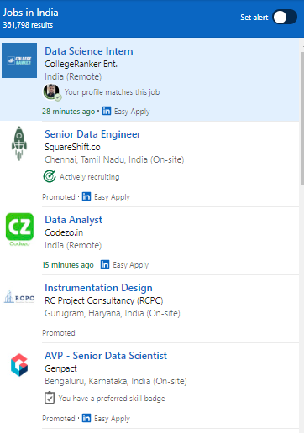
Web Scrape LinkedIn - Problem Statement
Extracting job data from all the pages of the LinkedIn
Converting data into csv files.
Connecting data and cleaning data.
Coming out with Insights.
Show and explain insights with
the help of dashboard.

Slide 5
Web Scrape LinkedIn - Challenges
Web scraping
Login in secure server
Automation
Extracting clean data
Correlating the data

Slide 6
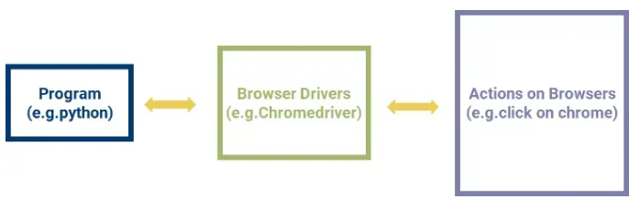
Web Scrape LinkedIn - Our Approach
For automation using Selenium Procedure and directly landed on LinkedIn job portal
Extracting data from first page then clicking one by one for all the pages to collecting data from them
Cleaning data and Manipulating data in SQL
Showing data and explaining data in Excel Dashboard

Slide 7
Web Scrape LinkedIn - Insights
Number of Jobs
1. on the basis of state
2. on the basis of city
Total applicant on the basis of Designation.
Top states having more numbers of employers.
Top Company with the highest followers.
Top company with highest sum of employees.

Slide 8
Web Scrape LinkedIn - Learnings
Selenium automation.
web scraping.
Login into secure server.
Extracting data and clean data.
Joining different type of data.
Creating dashboard for showing our insights.

Slide 9
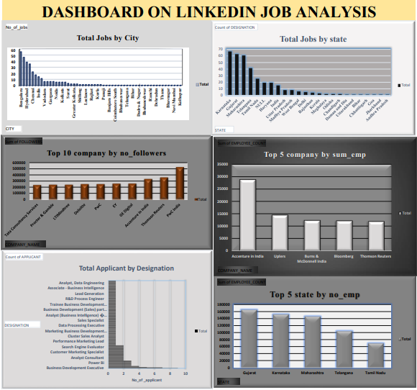
Web Scrape LinkedIn – RESULTS
D
A
S
H
B
O
A
R
D

Slide 10


